Slide 1

Clustering
Team Members:
1- Abdullah Abdelhakeem
2- Mohamed Mostafa
3- ElShaimaa Hassan
4- Mohamed Sebaie
5- Osama Ahmed
6- Lamiaa Omar
Supervisor: Dr/Shahira

Slide 2
01
02
03
04
05
06
Introduction
K-Means Algorithm
Mean-Shift Algorithm
K-Means/Mean-Shift Merging
DBSCAN Algorithm
Conclusion

Slide 3
Clustering/Cluster analysis is an unsupervised
machine learning task.
It involves automatically discovering natural grouping in data. Unlike supervised learning (like predictive modeling), clustering algorithms only interpret the input data and find natural groups or clusters in feature space.
Clustering

Slide 4
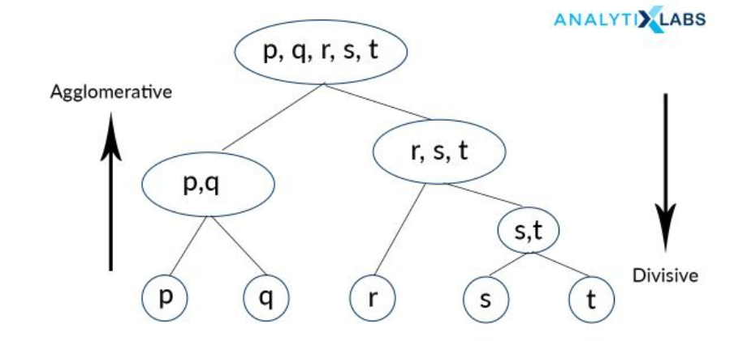
Types of Clustering
Clustering
Partitioning
Hierarchical
Density-Based
Model-Based
Grid-Based
- K Means
- K Medoids
- K Modes
- Agglomerative
( Bottom-Up )
- Divisive
( Top-Down )
- DBSCAN
- HDBSCAN
- Mean Shift
- EM
- COBWEB
- CLASSIT
- Sting
- WaveCluster

Slide 5
K-Means

Slide 6
K-Means
Definition
K-means clustering is a method of vector quantization, that aims to partition n observations into k clusters in which each observation belongs to the cluster with the nearest mean (cluster centers or cluster centroid), serving as a prototype of the cluster.

Slide 7
K-Means
Steps
Step-1: Select the number K to decide the number of clusters.
Step-2: Select random K points or centroids. (It can be other from the input dataset).
Step-3: Assign each data point to their closest centroid, which will form the predefined K clusters.
Step-4: Calculate the variance and place a new centroid of each cluster.
Step-5: Repeat the third steps, which means re-assign each datapoint to the new closest centroid of each cluster.
Step-6: If any reassignment occurs, then go to step-4 else go to FINISH.
Step-7: The model is ready.

Slide 8
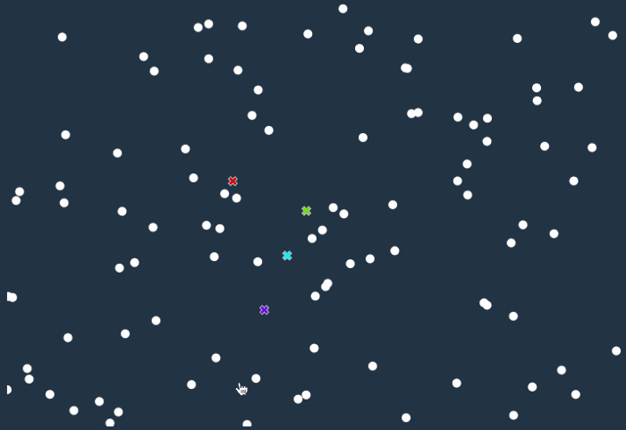
K-Means
Animations

Slide 9
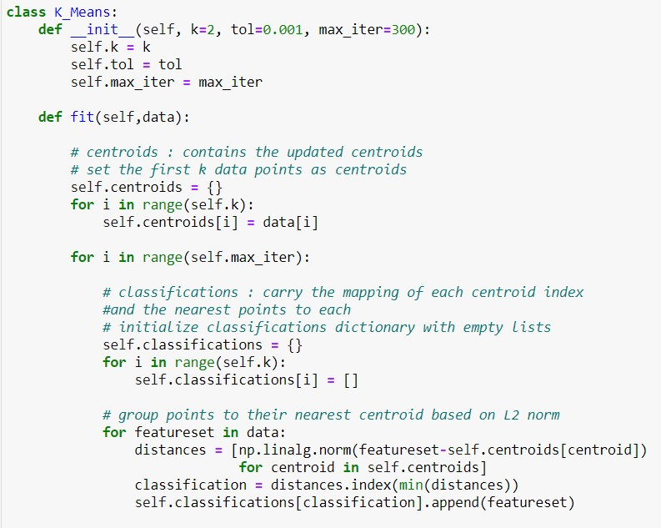
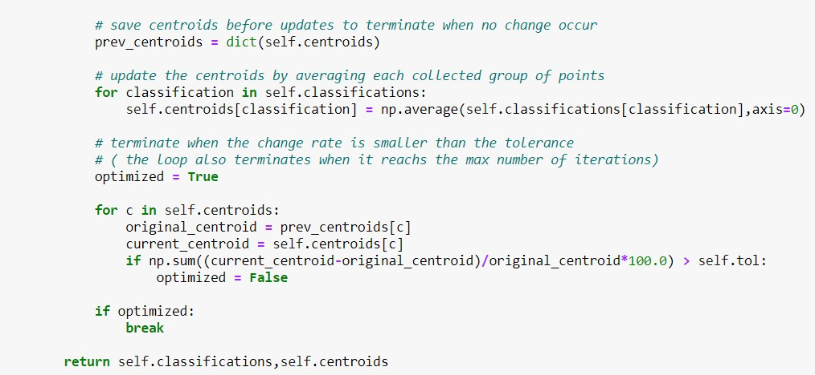
K-Means
Code

Slide 10
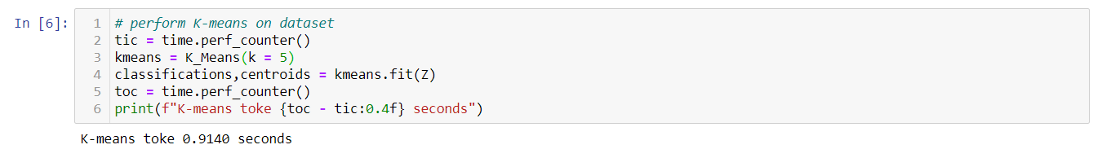
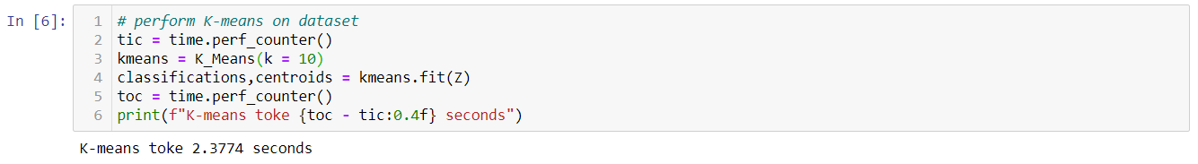
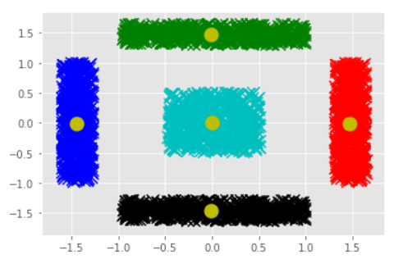
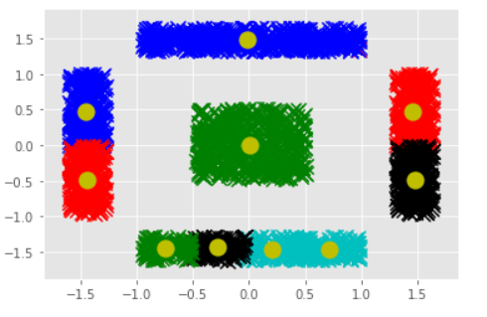
K-Means
Results ( K = 5 & K = 10 )

Slide 11
How to Find Optimum Value of K ?
There are some different methods to choose k value ,here we focus on elbow method:
This method uses the concept of WCSS ( Within Cluster Sum of Squares ) which defines the total variations within a cluster.
WCSS= ∑_{Pi in Cluster1} distance(P_{i} C₁)² +∑_{Pi in Cluster2} distance(P_{i} C₂)²+∑_{Pi in CLuster3} distance(P_{i} C₃)²
∑_{Pi in Cluster1} distance(P_{i} C₁)² : is the sum of the square of the distances between each data point and its centroid within a cluster1 and the same for the other two terms

Slide 12
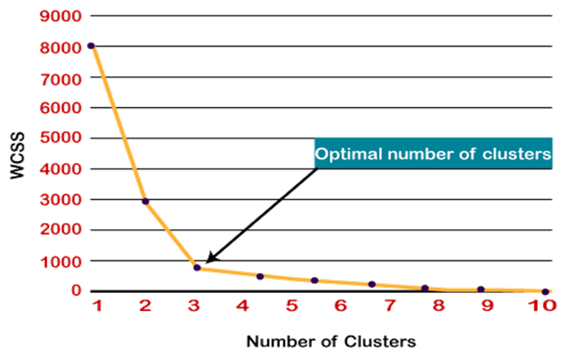
Elbow Method

Slide 13
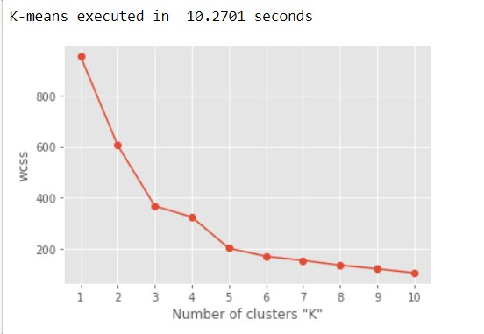
Elbow Method on dataset
Ideal K value =5

Slide 14
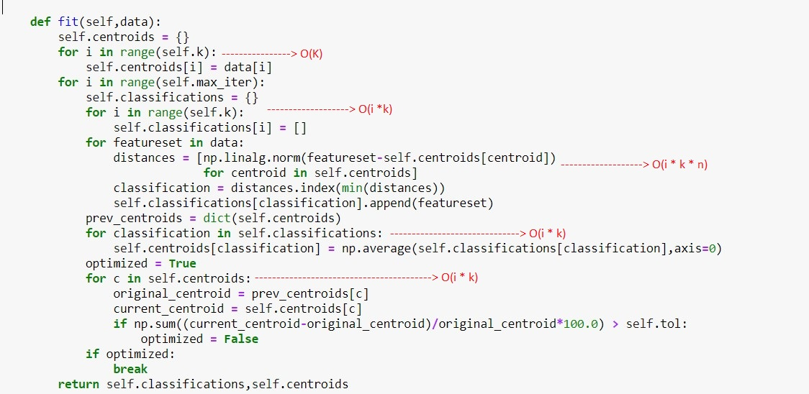
K-Means
Code Analysis

Slide 15

K-Means
Code Analysis
Assuming small features for the data
Space Complexity = max(O(k)+O(n*k) ≈ O(n)
For number of features in each data point = d
Space Complexity can be written as O(n*d)

Slide 16
K-Means
Advantages
It’s pretty fast as all it does is compute the distance between points, It thus has a linear complexity O(tkn), where n is number of points, k is number of clusters and t is number of iterations.
Relatively simple to implement.
Scales to large data sets.
Guarantees convergence.
Easily adapts to new examples.
Generalizes to clusters of different shapes and sizes, such as elliptical clusters.

Slide 17
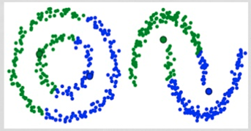
K-Means
Disadvantages
Choosing K manually.
Being dependent on initial values as it affects the final clusters.
Sensitive to clustering outliers.
Scaling with number of dimensions , As the number of dimensions increases, a distance-based similarity measure converges to a constant value between any given examples.
K-means can't handle non-convex sets.

Slide 18
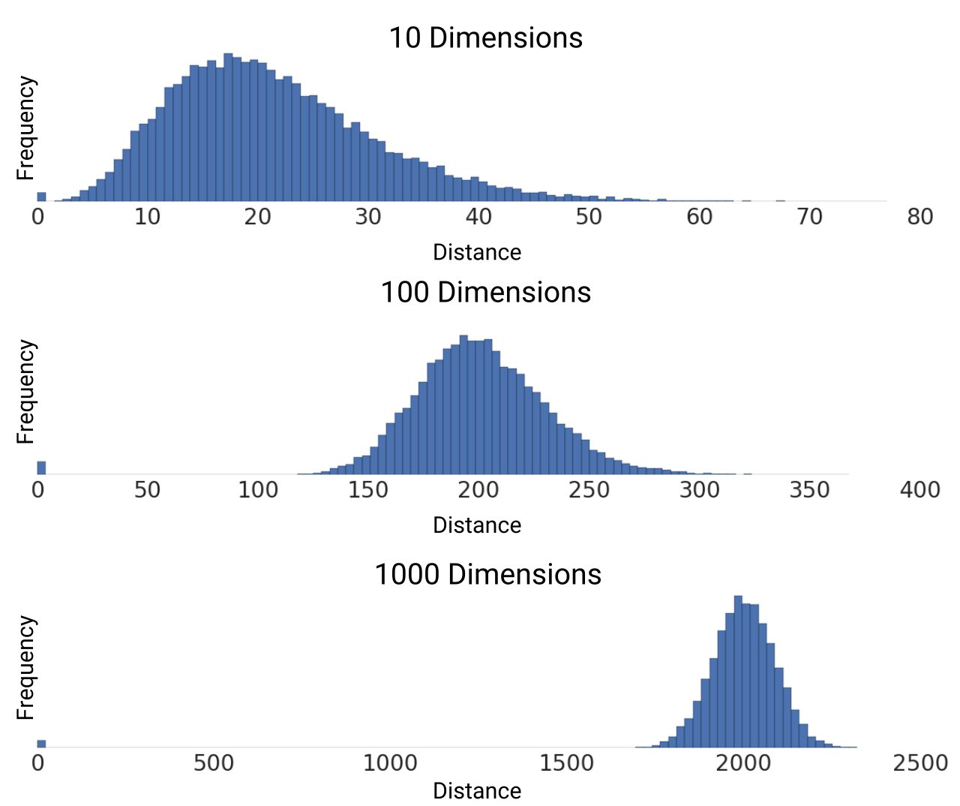
K-Means
Curse of Dimensionality

Slide 19
K-Means Applications
Insurance Fraud Detection
Search Engines
Customer Segmentation
Image Segmentation
Diagnostic Systems

Slide 20
Mean-Shift

Slide 21
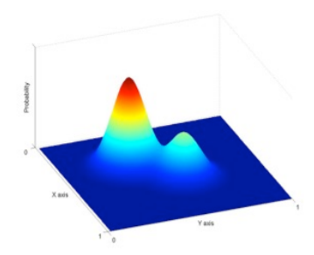
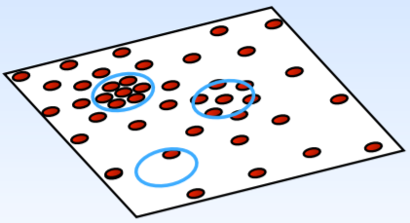
Mean-Shift
Definition
Mean-Shift is hierarchical density based clustering algorithm, it assigns the data points to the clusters iteratively by shifting points towards the mode (mode is the highest density of data points in the region, in the context of the Mean-Shift). As such, it is also known as the Mode-seeking algorithm.

Slide 22
Mean-Shift
Mean-Shift Algorithm Steps
Steps
Step-1: Start with the data points assigned to a cluster of their own.
Step-2: Calculate the mean of all the points lying inside this window.
Step-3: Shift the window, such that it is lying on the location of the mean.
Step-4: Iterate and move to the higher density region.
Step-5: Stop once the centroids reach at position from where it cannot move further.

Slide 23
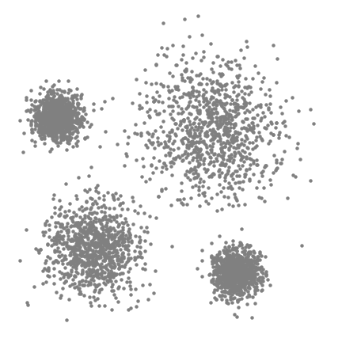
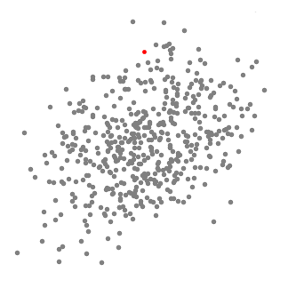
Mean-Shift
Animation

Slide 24
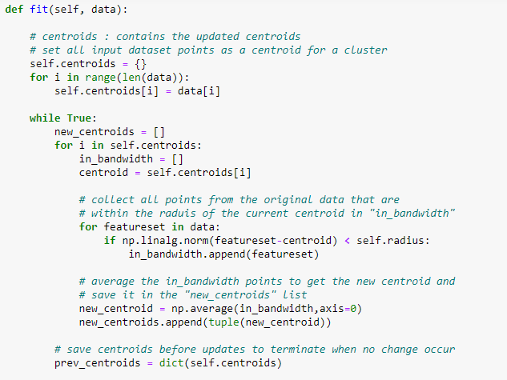
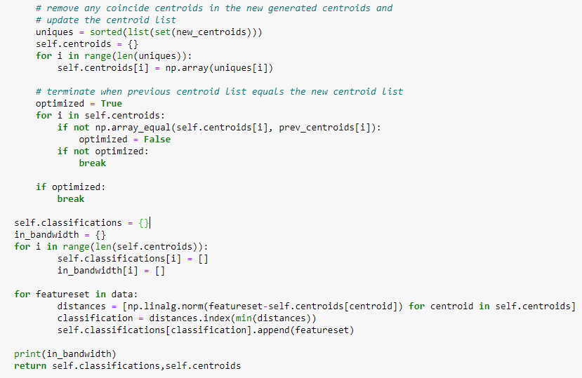
Mean-Shift
Code
Time : O( N^2 )
Space : O( N )

Slide 25
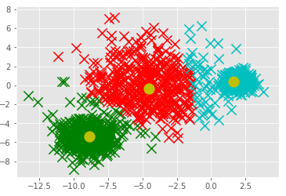
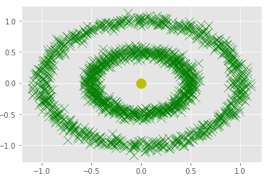
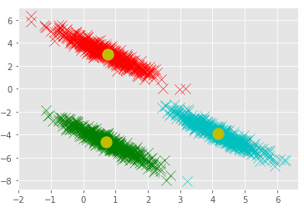
Mean-Shift
Results
R = 3.9
K = 1.4
K = 2.62

Slide 26
Mean-Shift
Advantages
No need to provide number of clusters (k) unlike k-means.
Automatically finds basins of attraction (maximum points)
One parameter choice (window size)
Robust to outliers.
Robust to noise within the data.

Slide 27
Mean-Shift
Disadvantages
Output depends on window size and window size (bandwidth) selection is not trivial.
Computationally expensive , as it has complexity of O(n^2).
Does not scale well to large data sets and large dimensions of feature space.

Slide 28


Mean-Shift
Applications
Clustering
Object Contour Detection
Image Segmentation
Object Tracking

Slide 29
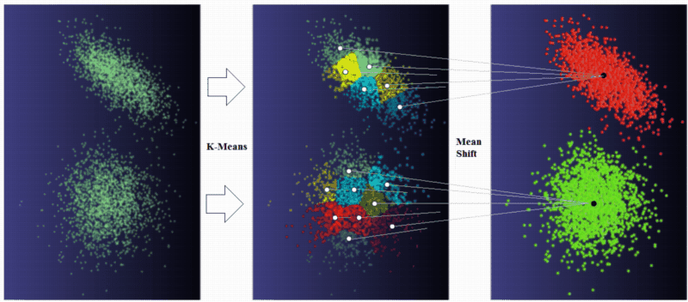
Merging Mean-Shift with K-Means

Slide 30
K-Means
Results ( K = 5 & K = 10 )

Slide 31
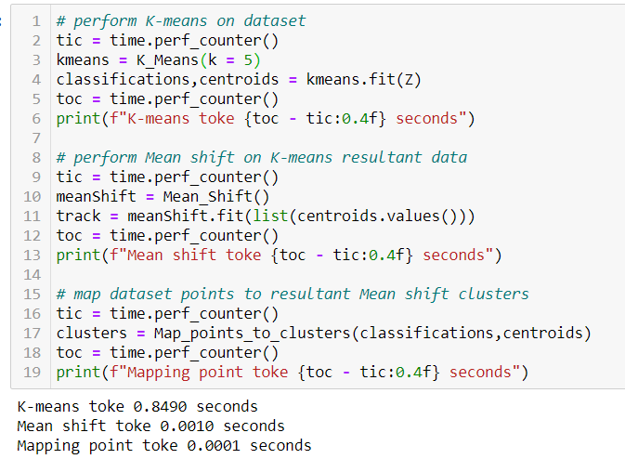
K-Means & Mean-Shift
Results ( K = 5 )

Slide 32
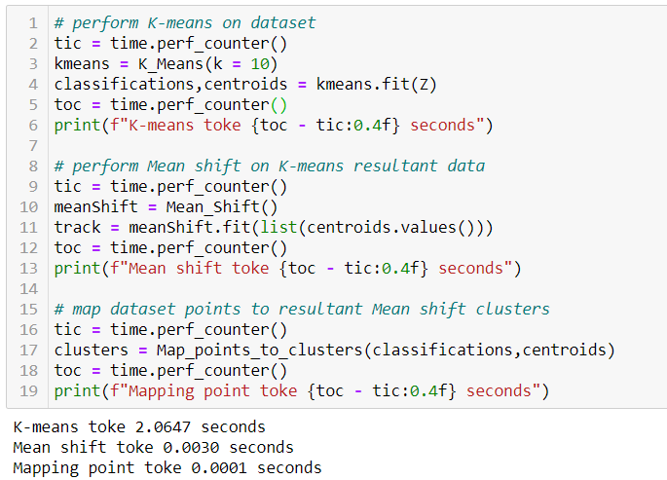
K-Means & Mean-Shift
Results ( K = 10 )

Slide 33
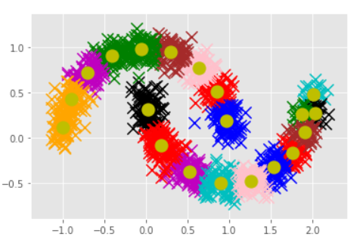
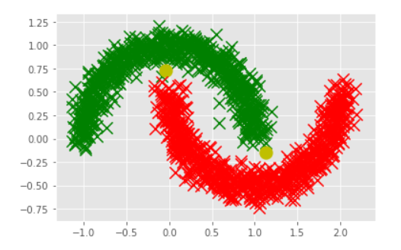
K-Means & Mean-Shift
Non-Convex Sets
K = 20

Slide 34
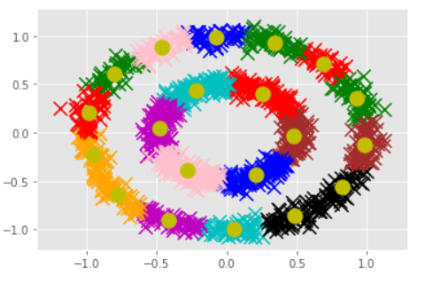
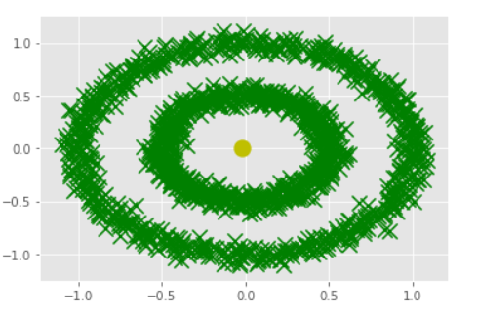
K-Means & Mean-Shift
Concentric Sets
K = 20

Slide 35
DBSCAN

Slide 36
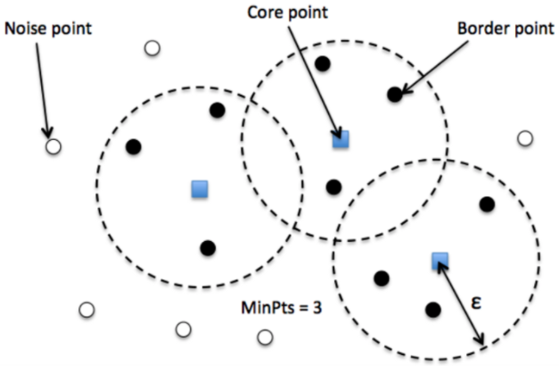
DBSCAN
Definition
DBSCAN ( Density-based spatial clustering of applications with noise ) is a density-based clustering.
Two parameters:
Eps (ε): Maximum radius of the neighborhood
MinPts: Minimum number of points in the Eps-neighborhood of a point

Slide 37
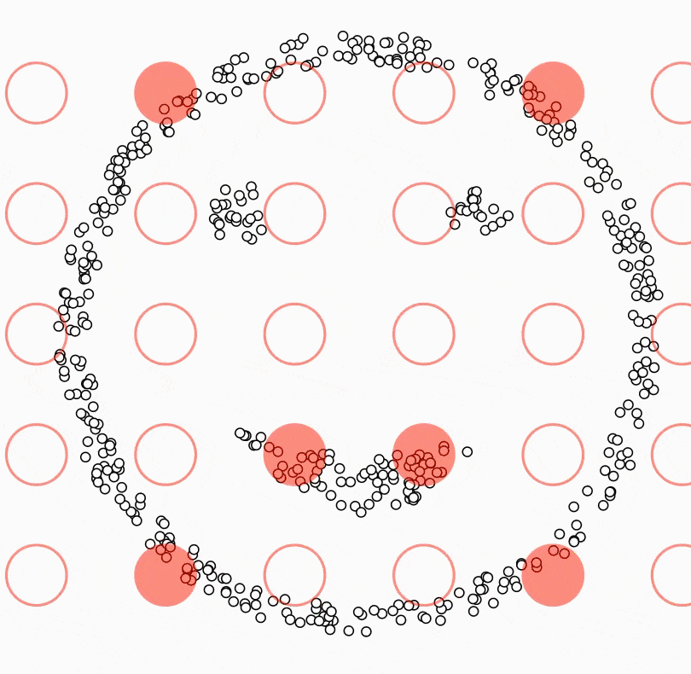
DBSCAN
Animation

Slide 38
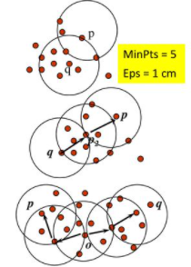
Density-Reachable and Density-Connected
Let q be a core point, then every point in its Eps neighborhood is said to be directly density-reachable from q.
A point p is density-reachable from a point core point q if there is a chain of points.
A point p is density-connected to a point q if there is a point o such that both, p and q are density-reachable from o.

Slide 39
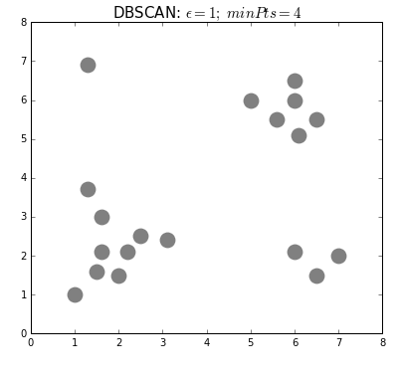
DBSCAN
Steps
Step-1: Find for a point in the dataset ,the neighbor points within eps and identify if it is outlier or the core points.
Step-2: For each core point assigned it to a cluster.
Step-3: Find all its density connected points and assign them to the same cluster as the core point.
Step-4: Repeat until all all point assigned to cluster.

Slide 40
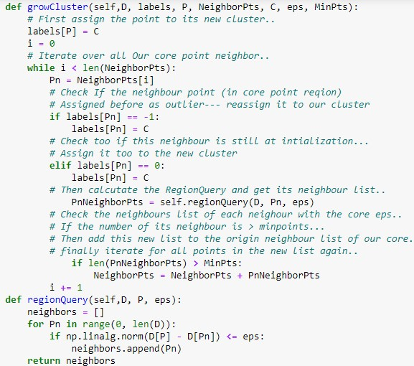
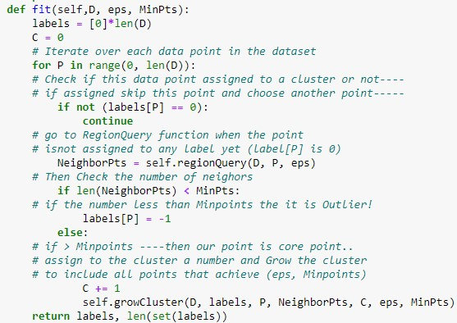
DBSCAN
Code

Slide 41
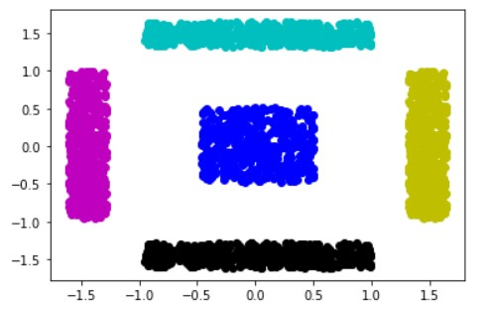
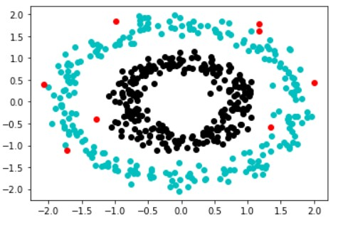
DBSCAN
Code Output

Slide 42
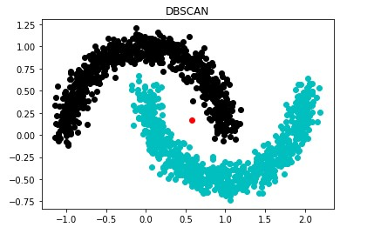
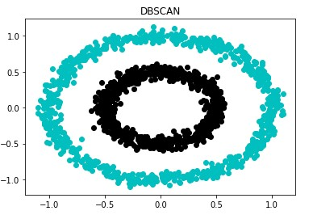
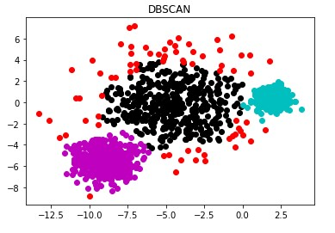
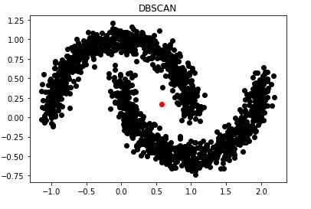
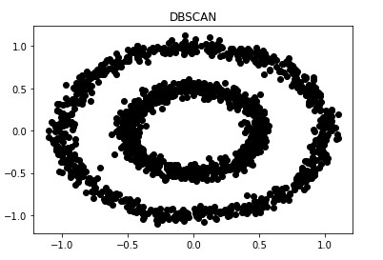
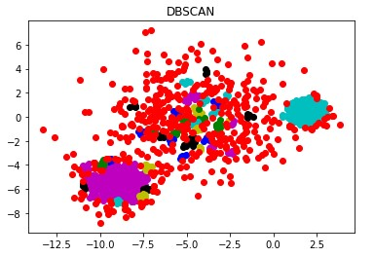
DBSCAN
Epsilon & MinPoints Effect
eps= 0.15
minpoints=4
eps= 0.18
minpoints=4
eps= 1
minpoints=15
eps= 0.18
minpoints=4
eps= 0.20
minpoints=4
eps= 0.25
minpoints=4

Slide 43
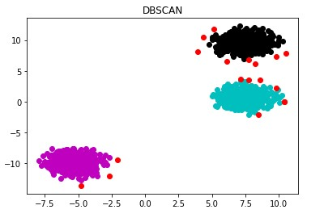
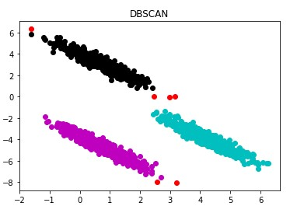
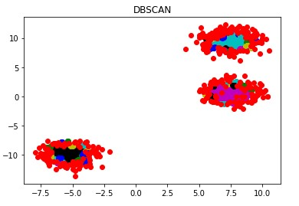
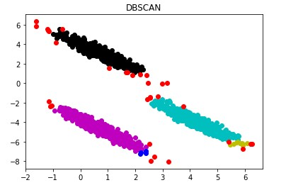
DBSCAN
Epsilon & MinPoints Effect
eps= 0.7
minpoints=8
eps= 0.6
minpoints=4
eps= 0.20
minpoints=4
eps= 0.25
minpoints=4

Slide 44
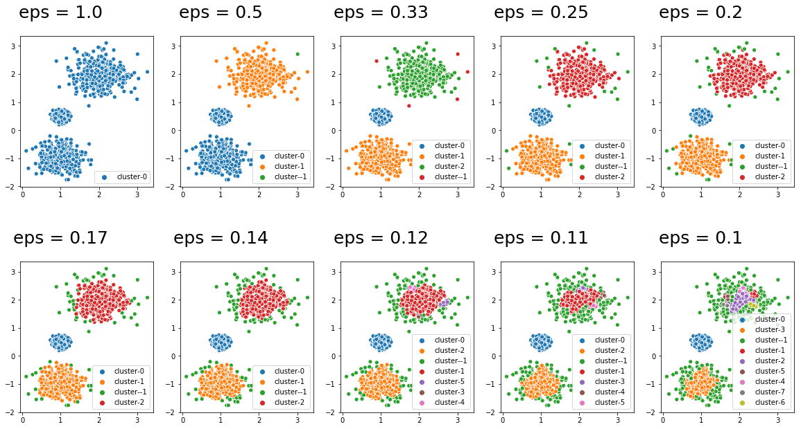
DBSCAN
Epsilon Effect

Slide 45
“MinPts” Selection
Here are a few rules of thumb for selecting the MinPts value:
The larger the data set, the larger the value of MinPts should be.
If the data set is noisier, choose a larger value of MinPts.
Generally, MinPts should be greater than or equal to the dimensionality of the data set.
For 2-dimensional data, use DBSCAN’s default value of MinPts = 4.
If your data has more than 2 dimensions, choose MinPts = 2*dim, where dim= the dimensions of your data set.

Slide 46
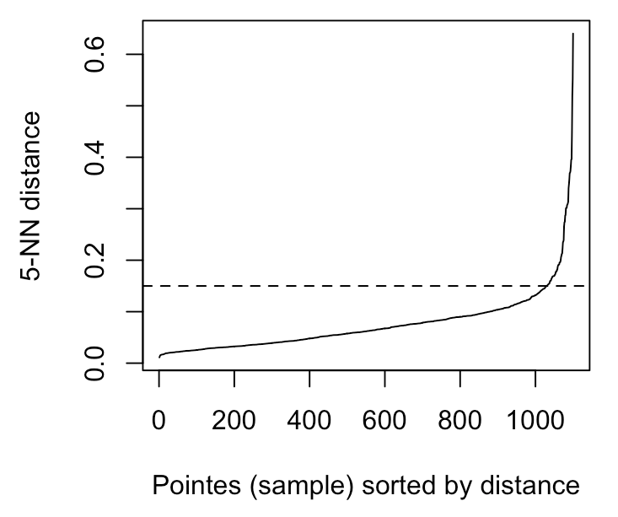
Epsilon (ε) Selection
KNN calculates the average distance between each point and its k nearest neighbors.
The average k-distances are then plotted in ascending order on a k-distance graph.
You’ll find the optimal value for ε at the point of maximum curvature (i.e. where the graph has the greatest slope).
Eps =0.178

Slide 47
DBSCAN
Advantages
Number of clusters is not required.
It can find any shape cluster even if the cluster is surrounded by any other cluster.
It can easily find outliers in data set.
It is the second most used clustering method after K-means.

Slide 48
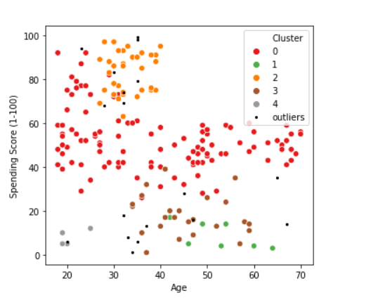

DBSCAN
Disadvantages
The quality of the result depends on the distance measure used in the regionQuery function.
It can be expensive when cost of computation of nearest neighbor is high.
It can be slow in execution for higher dimension.
Not Suitable if dataset is too sparse.
Sensitive to eps and Minpts.

Slide 49


DBSCAN
Code Analysis
Frequency Count Method
Complexity Space = O(n)

Slide 50
DBSCAN
Applications
Scientific Literature
Image of Satellite
Crystallography of X-Ray
Anomaly Detection in Temperation Data

Slide 51




DBSCAN
Applications

Slide 52
Conclusion
 | K-Means/Mean-Shift | DBSCAN
Time Complexity | O( nI ) | O( n^2 )
Clustering Type | Partitional Clustering | Density Based Clustering
Paradigm | Greedy Algorithm | Greedy Algorithm
Outlier Detection | Can not Handle Outliers | Can Handle Outliers

Slide 53



Conclusion
K-Means/Mean-Shift
DBSCAN

Slide 54
References
http://jamesxli.blogspot.com/2012/03/on-mean-shift-and-k-means-clustering.html
https://www.geeksforgeeks.org/dbscan-full-form/
https://www.tutorialspoint.com
https://en.wikipedia.org
https://www.analyticsvidhya.com/blog/2020/09/how-dbscan-clustering-works/
https://developers.google.com/machine-learning/clustering/algorithm/advantages-disadvantages
https://towardsdatascience.com/how-to-use-dbscan-effectively-ed212c02e62
https://www.slideshare.net/MahbuburShimul/dbscan-algorithom
https://www.kaggle.com/datark1/customers-clustering-k-means-dbscan-and-ap

Slide 55
Any Questions ?

Slide 56
THANKS!

